Slide 1
Data virtualization Denodo
Pablo Frutos García, 22 Sep 2017

Slide 2
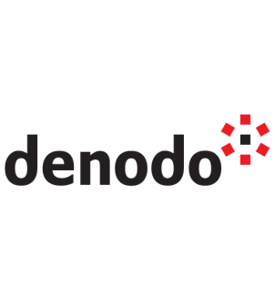
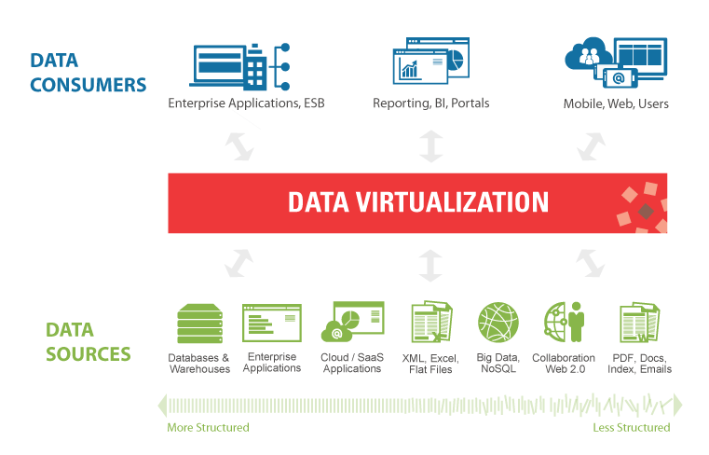
Data Virtualization
Challenge:
Data virtualization is modern data integration. It performs many of the same transformation and quality functions as traditional data integration but leveraging modern technology to deliver real-time data integration at lower cost, with more speed and agility. Denodo is one of the two platforms that allow data virtualization.
Proposal:
1) Create fast a simple API Rest platform with Denodo, using at least 3 different types of related data sources as input.
2) ETL functions (join, expression, filtering) will be tested.
3) Association between entities (useful to reporting) will be tested.
4) Test execution of the API through web-based app (internal to Denodo).
5) Add a new source, testing avilability and consistency of information.
6) If possible, set and test security layer
Optional: Ideally, if time allowes it, to test the read of the data with some Data Consumer app (BI reporting tool for example).
Benefit:
Improve development time and cost, reducing it till 50%
Offer an abstraction layer and data services layer, allowing better flexibility between layers of information and business technology.

Slide 3
Pre requisites
Denodo Platform for AWS
Oracle or MySQL database to create sources
Sftp server to read flat files, xml, json…
Cloud based app/api choice (as source)

Slide 4
Estimation
9 man days for development and testing including:
Use of Denodo platform AWS
Configuration for sources of data
+ steps described in the proposal
On current capacity of about 100% it will take about 9 days

Slide 5
Output
News: Fast introduction to data virtualization and denodo
Video: Basic use of Denodo AWS Platform
Power Point: Advantages of Data Virtualization – Future proof and faster development

Slide 6
Pablo Frutos García
pablo.frutos@gft.com

